Slide 1
Food Safety Traceability: Discussion on FDA’s Proposed Rule
Empowering Indian Country through economic development and greater food access

Slide 2
Agenda
About IFAI
Food Safety Modernization Act
Managing Supply Chain Relationships
Proposed Rule on Traceability
Building on the Baseline

Slide 3
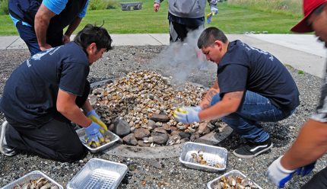
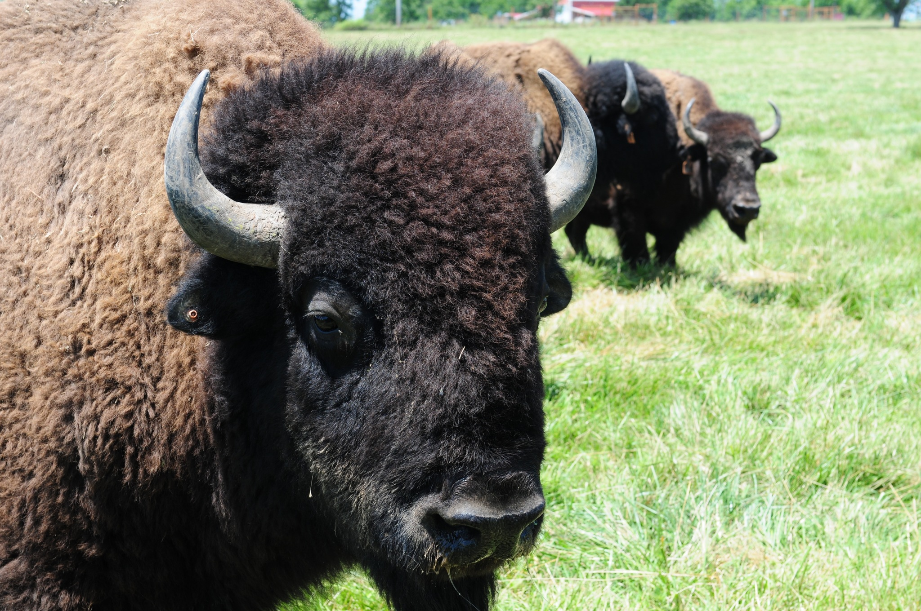
Indigenous Food and Agriculture Initiative University of Arkansas Office of Economic Development
Indigenous Food and Agriculture Initiative
Our Founding
Established in the University of Arkansas School of Law in 2013 by:
Dean Emeritus Stacy Leeds; and
Founding Director Janie Simms Hipp
Our Mission
Enhance health and wellness in tribal communities by advancing healthy food systems, diversified economic development, and cultural food traditions in Indian Country.

Slide 4
Our Work in Indian Country
Our Work in Indian Country
Model Tribal Food and Agriculture Code
Cultivating Tribal Food Sovereignty
Facilitating agricultural production through tribal food sovereignty
Comprehensive set of food and agriculture laws for review, adoption, and implementation by tribes
Food and Agriculture ‘Scaling Up’
Native Farm Bill Coalition
Agricultural production tools and economic forecast models to help build strong Tribal food businesses and food systems
Research partner for the largest-ever coordinated effort in Indian Country around federal food, agriculture, and nutrition policy
Tribal Hemp
Tribal Food Safety Alliance
Policy research and analysis of industrial hemp production
Providing education, training, and outreach to tribal nations and communities, food growers, processors, and manufacturers on FSMA
Food Security and Access
Development of educational resources and research for child nutrition and food access programs in Indian Country
Native Youth in Food and
Agriculture Leadership Summit
Food and agricultural production and policy skills-development leadership summit for Indigenous youth

Slide 5
Food Safety Modernization Act
Enacted by Congress in 2011 as a law of general applicability
Establishes a national standard for food safety risk mitigation and response across the food supply chain
Designated the U.S. Food and Drug Administration (FDA) with regulatory authority
FDA Published 7 Main Rules
Produce Safety
Sanitary Transportation of Human & Animal Food
Foreign Supplier
Verification Program
Accreditation of 3rd Party Auditors & Certification Bodies
Preventive Controls for Human Foods &
Preventive Controls for Animal Foods
Prevention of Intentional Contamination / Adulteration
Notes:
Approx 40% of crops by value sales are fruits, vegetables, nursery crops
Approx 1/3 of crop farms focus on these areas

Slide 6
Managing Supply Chain Relationships
Node
Understanding where you are in the supply chain can promote resilience in your distribution channels
Link
Ag Enterprise

Slide 7
Managing Supply Chain Relationships
2nd Tier Vendors
Node
Understanding where you are in the supply chain can promote resilience in your distribution channels
The Food Safety Modernization Act generally only requires you to assess
All Nodes 1 Link Up
All Nodes 1 Link Down
Supply chain mapping is your first step at acknowledging the Traceability of an agriculture product
Link
1st Tier Vendors
Or Land for Farms
Ag Enterprise
1st Tier Customers
2nd Tier Customers

Slide 8
Proposed Rule on Food Traceability
Traceability – the ability to track how a food product is produced; moves, is sold, or otherwise distributed; and is altered (processed or manufactured, if applicable) along the food supply chain.
The importance of recordkeeping cannot be understated:
Good records affirm proactive food safety activities and reduce economic harms associated with a recall.
On September 23, 2020, FDA has published a proposed rule listing Key Data Elements (KDEs) across Critical Tracking Events for foods identified on a Food Traceability List
Notes:
NOTE: FDA’s proposed traceability records are different from the records required under the Produce Safety Rule

Slide 9
Food Safety Risk Management: Outbreaks in Fresh Produce
FDA Outbreaks Linked to Produce Contamination Likely Prior to Retail
Notes:
These graphs highlight the diversity of produce items that have been implicated in foodborne illness outbreaks where the source of the outbreak likely occurred prior to retail or consumer preparation.
Ultimately, contamination can happen to any produce commodity; therefore, preventing contamination is critical for all fruit and vegetable growers.
For this reason, the FSMA Produce Safety Rule does not target specific commodities, but instead, focuses on the practices which reduce risks. Read more about the FDA’s approach to produce regulation in the “Additional Resource” section below.
1996-2014 Pie chart notes:
*One outbreak of Cyclospora associated with raspberries in 1997 accounts for 1,012 illnesses, with no information on hospitalizations and deaths.
** Two outbreaks in 2004 were associated with mesclun lettuce and/or basil.
*** “Other” includes one outbreak associated with each of the following commodities: celery, hazelnuts, hot peppers, pine nuts, pistachios, snow peas, and squash. The single Salmonella Saintpaul outbreak associated with hot peppers accounts for 1,535 illnesses, 308 hospitalizations, and 2 deaths.
+ Five outbreaks during this time period were associated with unknown produce; while no specific produce item was identified as the vehicle for these outbreaks, various produce items were found to be epidemiologically associated with illness.
2015-2019 Pie chart notes:
*One outbreak of Hepatitis A associated with frozen strawberries implicated 143 illnesses across 9 states with 56 reported hospitalizations and 0 reported deaths.
*** “Other” includes one outbreak associated with pistachios.
+Three outbreaks during this time are associated with unknown origin. Each outbreak corresponds with produce sold at retail in mixed packaging, e.g. salad mix, fruit mix, vegetable trays.
Other Notes:
These data do not contain information on outbreaks/illnesses where the point of contamination is the retail food setting or home.
These data do not include illnesses transmitted from person-to-person.
Illness data represent only the number of illnesses reported to CDC, FDA, and state/local health departments in association with an outbreak. These data do not include illnesses that may have occurred but were not reported, sporadic cases of illness, and illnesses not associated with a food vehicle.
Information on outbreaks/illness reported prior to 2004 has been compiled from paper records; information on outbreaks/illnesses since 2004 has been obtained from the CFSAN Outbreak Surveillance Database.
The outbreaks tracked by FDA are a subset of all the outbreaks tracked by CDC. CDC also tracks outbreaks/illnesses where the point of contamination is the retail food setting or the home. Due to lags in reporting of illnesses, some differences in numerical tallies may exist between FDA and CDC data.
Slide Reference:
The Centers for Disease Control & Prevention (CDC). (2013). Produce Outbreak Data. Prepared by CORE Post Response Team on January 13, 2013.
D'Lima, C., & Vierk, K. (2011). Memorandum to the Record. In: Produce Related Outbreaks and Illnesses. Food and Drug Administration.
Merriweather, S., Cloyd, T.C., & Gubernot, D. (2015). Memorandum to the File — Produce Related Outbreaks and Illnesses 2011–2014. In: Produce Related Outbreaks and Illnesses. Food and Drug Administration.
Additional Resource:
FDA Fact Sheet. Why doesn’t this rule only target fruits and vegetables that are known to have caused outbreaks of foodborne illness?: http://wayback.archive-it.org/7993/20170111192634/http://www.fda.gov/downloads/Food/GuidanceRegulation/FSMA/UCM360758.pdf

Slide 10
Proposed Rule on Food Traceability
Food Traceability List
FDA developed a Risk-Ranking Model for foods requiring additional tracing based on micro-biological foodborne illnesses. This list refers to single ingredient foods and any recipe containing these foods as ingredients.
Critical Tracking Events
Nodes or areas of activity that trigger traceability records
Growing
Receiving
Creating
Transforming
Shipping
Key Data Elements
Information necessary in recordkeeping across critical tracking events

Slide 11
Foods | Description
Soft Cheeses | Includes all soft ripened or semi-soft cheeses, and fresh soft cheeses that are made with pasteurized or unpasteurized milk
Shell eggs | The egg of the domesticated chicken
Nut butter | Includes all types of tree nut and peanut butters; does not include soy or seed butters
Cucumbers | Includes all variety of cucumber
Herbs (fresh) | Includes all types of leafy greens, such as lettuce, kale, chicory, watercress, chard, arugula, spinach, pak choi, sorrel, collards, and endive
Leafy Greens | Includes all types of leafy greens, such as lettuce, kale, chicory, watercress, chard, arugula, spinach, pak choi, sorrel, collards, and endive
Melons | Includes all types of melons, such as cantaloupe, honeydew, and watermelon
Peppers | Includes all varieties of peppers
Sprouts | Includes all varieties of sprouts
Tomatoes | Includes all varieties of tomatoes
Tropical tree fruits | Includes all types of tropical tree fruit, such as mango, papaya, mamey, guava, lychee, jackfruit, and starfruit
Fruits and vegetables (fresh-cut) | Includes all types of fresh-cut fruits and vegetables
Finfish including smoked finfish | Includes all finfish species, such as cod, haddock, Alaska pollack, tuna, mahi mahi, mackerel, grouper, barracuda and salmon; does not include siluformes fish, such as catfish
Crustaceans | Includes all crustacean species, such as shrimp, crab, lobster, and crayfish
Mollusks, bivalves | Includes all species of bivalve mollusks, such as oysters, clams, and mussels; does not include scallop adductor muscle
Ready-to-eat deli salads | Includes all types of ready-to-eat deli salads, such as egg salad, potato salad, pasta salad, and seafood salad; does not include meat salads

Slide 12
Critical Tracking Events
Growing: On-farm production of foods on Food Traceability List (FTL)
Shipping: An event in a food’s supply chain in which a food is arranged for transport from a defined location to another defined location
Creating: Making or producing of a food on the Food Traceability List through manufacturing or processing using only ingredients not on the FTL
Receiving: An event in a food’s supply chain in which a food is received by a customer (other than a consumer) at a defined location after being transported from another defined location
Transforming: An event in the food’s supply chain changing a food on the Food Traceability List, its package, and/or its label, such as by combining ingredients or processing food

Slide 13
Key Data Elements
Additional KDEs for Sprouts
Link Traceability Lot Code to…
Growing area coordinates
FTL Foods
Shell eggs
Cucumbers
Herbs
Melons
Leafy greens
Peppers
Sprouts
Tomatoes
Tropical tree fruits
Growing

Slide 14
Key Data Elements
Additional for Sprout Growers
Grower of Seed for Sprouting
Location identifier & description
Associated Seed Lot Code
Date of harvesting
Seed supplier
Location identifier & description
Taxonomic name of seeds
Growing Specs
Volume
Type of Packaging
Antimicrobial Treatment
Associated Seed Lot Code
Master lot & sub-lot codes
Seed Processor/Conditioner
Location identifier & description
Associated Seed Lot Code
Date of Conditioning/Processing
Sprouter
Any New Lot Code
Date of Receipt by Sprouter
Sprout Traceability Lot Code(s)
Associated Date(s) of Production
All Seed Packinghouse(s)
Location identifier & description
Associated Seed Lot Code
Date of Conditioning/Processing

Slide 15
Key Data Elements
Additional KDEs for Sprouts
Link Traceability Lot Code to…
Entry number(s) assigned to the food (if imported)
Quantity and unit of measure of the food
Traceability product identifier & description of the food
Lot Code Generator’s location identifier, description, and POC
Shipment location’s identifier and location
Date/time of shipment
Reference record type(s) and number(s) for shipment documents
Transporter’s name
Shipping
Shipper must keep above records
Shipper must also transmit above records except
reference record type & number & transporter’s name

Slide 16
Key Data Elements
Additional if Shipper is a Farm
Cold Storage (if not shipper)
Location identifier & description
Date/time of cooling
Statement that shipper is a farm
Originator of Food (if not shipper)
Location identifier & description
Packer (if not the shipper)
Location identifier & description
Date/time of packing
Harvester of Food (if not shipper)
Business name
POC
Phone number
Date/Time of Harvesting

Slide 17
Key Data Elements
Additional KDEs for Sprouts
Link Traceability Lot Code to…
Location identifier & description
Date “creation” completed
Traceability product identifier & description of food
Quantity and unit of measure
Reference record type(s) and number(s) relating
FTL Foods
Creating
Soft cheeses
Nut butter
Fresh-cut Fruits & Vegetables
Ready-to-eat deli salads

Slide 18
Key Data Elements
Additional KDEs for Sprouts
Link Traceability Lot Code to…
Traceability product identifier & description
Quantity of each traceability lot of the food used in transformation
New traceability product identifier and description for food produced in transformation
Quantity and unit of measure of food produced through transformation (e.g., 100 tanks, 200 lbs.)
Reference record type(s) and number(s) for records relating to transformation
Transforming
Manufacturing/Processing an FTL Food to make Another Food Product

Slide 19
Key Data Elements
Additional KDEs for Sprouts
Link Traceability Lot Code to…
Location identifier & description from immediate previous source (not the transporter)
Entry number assigned to the food (if imported)
Location identifier & description of where the food was received
Date/time the food was received
Quantity and unit of measure of the food (e.g., 6 cases, 25 returnable plastic containers)
Traceability product identifier & product description
Location identifier, description, and POC for traceability lot code generator
Reference record type(s) and reference record number(s), e.g., invoice number or bill of lading, for receipt of food
Name of transporter who transported the food to the receiver
Receiver

Slide 20
Key Data Elements
Additional KDEs for Sprouts
Link Traceability Lot Code to…
Location identifier & description from immediate previous source (not the transporter)
Entry number assigned to the food (if imported)
Location identifier & description of where the food was received
Date/time the food was received
Quantity and unit of measure of the food (e.g., 6 cases, 25 returnable plastic containers)
Traceability product identifier & product description
Location identifier, description, and POC for traceability lot code generator
Reference record type(s) and reference record number(s), e.g., invoice number or bill of lading, for receipt of food
Name of transporter who transported the food to the receiver
Receiver

Slide 21
Additional Considerations for First Receivers
First Receiver: First person (other than a farm) who purchases and takes physical possession of a food on the FTL
1
KDEs
First Receivers except from Fish Vessel
First Receivers after Fishing Vessels
General
Traceability lot code
Location identifier & description of food originator
From Food Harvester
Business name
Phone number and POC
Date/time of harvest
From Food Cooler (if applicable)
Location identifier & description
Date/time of cooling
From Food Packer
Location identifier & description
Date/time of packing
General
Traceability lot code
Harvest date range
Locations for trip (National Marine Fisheries Service Ocean Geographic Code or geographical coordinates)
Only foods that are originated can have a first receiver:
Grown
Raised
Caught
Harvested, i.e., eggs
Notes:
If the traceability lot code has not been previously established, they would need to develop one, linking all KDE records to this traceability lot code

Slide 22
Full Exemptions
Growers
Creators/Transformers
Note: When met, these exemptions extend to all Critical Tracking Events
Food Access Points
<$25K
average annual sales during past 3 yrs.
501(c)(3) Non-profit Food Establishments
<3K
Food on FTL receives commercial processing (“kill step”) that reduces presence of microorganisms of public health significance
Laying hens with respect to shell eggs produced
Non-food establishments like apartments or offices that hold food
Food on the FTL sold direct to consumer
All eggs on farm receive a treatment as outlined in the Egg Safety Rule
NOTE:
Commercial markets may still require enterprises maintain these records.
Food produced & packaged on farm*
Shipping
Food identified as Rarely Consumed Raw by FDA
Transporters of FTL foods exempt from shipping record requirements
Food produced for personal consumption
Notes:
For food produced and packaged on farm,
The packaging must
Be intact until it reaches its consumer.
Keep the integrity of the product
Stop the product from being contaminated or adulterated in transit
The labeling must provide
The name of the farm business
The full address of the farm
A business phone number

Slide 23
Partial Exemptions
Commingling Raw Agricultural Products Post-Harvest, Pre-Processing not subject to PSR
Exempt entities that must register through FDA’s Food Facility Registration System must maintain records identifying…
Immediate previous source of food
Immediate subsequent recipient of food
Fishing vessels
Entities that must register through FDA’s Food Facility Registration System must maintain records identifying…
Immediate previous source of food
Immediate subsequent recipient of food
Retail Food Establishments purchasing FTL directly from a farm
Only need to establish and maintain record for 180 days including information on…
Name and address of farm sourcing the food
FDA solicited comments for whether small Retail Food Establishments with less than 10 full-time equivalent employees would be exempt or partially exempt from this rule.
Farm to School and/or Farm to Institution
Only need to establish and maintain record for 180 days including information on…
Name and address of farm sourcing the food
Notes:
Commingling means products are mixed post-harvest but pre-processing. FDA provides the example of shell eggs mixed from separate farms under different management before packing.

Slide 24
Critical Tracking Events Across Supply Chain
FDA published examples of where CTEs fall on supply chain…
Creating
Growing
Fishing Boat
Seafood Processor
Distributor
Restaurant
1
Seafood
Transforming
1st Receiver
1
Shipping
Receiver
Notes:
If the traceability lot code has not been previously established, they would need to develop one, linking all KDE records to this traceability lot code

Slide 25
Critical Tracking Events Across Supply Chain
FDA published examples of where CTEs fall on supply chain…
Seed Grower/Harvester
Seed Processor
Seed Packinghouse
Seed Supplier
Creating
Growing
1
Transforming
1st Receiver
Sprouts
Sprouter
Distributor
Grocery Store
Shipping
Receiver
1

Slide 26
Critical Tracking Events Across Supply Chain
FDA published examples of where CTEs fall on supply chain…
Pepper Grower/Harvester
On-Farm Cooler
On-Farm Packinghouse
1
Creating
Transforming
1st Receiver
Receiver
Shipping
Growing
Processor
Distributor
C-Store
Pepper
Poppers
Dairy Farm
Soft Cheese Manufacturer
Distributor
1

Slide 27
Blending CTEs with Produce Safety Rule Affirmations
Example: Tomatoes Intended to be Processed with a “Kill Step” to Make Pasta Sauce…
Commercial Composter
Tomato Farm
On-Farm Packinghouse
Sauce Processor
Distributor
C-Store
Public Water for Irrigation
1
Affirmations Farm Should Receive (PSR)
Commercial Composter
Supplier complied with scientifically valid process
Supplier stored compost in a way that minimizes risk of contamination
Public Water Source (subject to change)
Copy of test results or current certificate of compliance
Food Processing
Affirmation of commercial processing with “kill-step”
Transforming
1st Receiver
Receiver
Shipping
Creating
Growing
Notes:
Soil Amendments
For biological soil amendments of animal origin that are received from a third party, documentation must be provided and kept by the grower to show the process used to treat the soil amendment is a scientifically valid process that has been carried out with appropriate process monitoring and prove that it has been handled in a way that minimizes the risk of contamination (§ 112.60(b)(1)).
The documentation must be renewed at least annually (§ 112.60(b)(1)).
As a best practice, the process should be periodically verified through testing.
Some suppliers may not have documentation of the treatment process (e.g., certificate of conformance). If they do not, there is no way to know the process they have used. Those subject to the rule must handle these soil amendments the same as they would an untreated amendment, or consider finding another supplier who can supply the appropriate documentation.
Public Water:
§ 112.46(a)(1) and (a)(2) state that if water is sourced from a public water supply (such as municipal drinking water), growers subject to the rule do not need to test the water source as long as they have Public Water System results or a current water supply certificate of compliance that the water meets requirements of the Safe Drinking Water Act, or that it is free of detectable generic E. coli in 100 mL of water.
Commercial Processing with “Kill Step”
§ 112.2(b)
(b) Produce is eligible for exemption from the requirements of this part (except as noted in paragraphs (b)(1), (2), and (3) of this section) under the following conditions:
(1) Produce receives commercial processing that adequately reduces the presence of microorganisms of public health significance. Examples of commercial processing that adequately reduces the presence of microorganisms of public health significance are processing in accordance with the requirements of part 113, 114, or 120 of this chapter, treating with a validated process to eliminate spore-forming microorganisms (such as processing to produce tomato paste or shelf-stable tomatoes), and processing such as refining, distilling, or otherwise manufacturing/processing produce into products such as sugar, oil, spirits, wine, beer or similar products; and
(2) You must disclose in documents accompanying the produce, in accordance with the practice of the trade, that the food is ‘‘not processed to adequately reduce the presence of microorganisms of public health significance;’’ and
(3) You must either:
(i) Annually obtain written assurance, subject to the requirements of paragraph (b)(6) of this section, from the customer that performs the commercial processing described in paragraph (b)(1) of this section that the customer has established and is following procedures (identified in the written assurance) that adequately reduce the presence of microorganisms of public health significance; or
(ii) Annually obtain written assurance, subject to the requirements of paragraph (b)(6) of this section, from your customer that an entity in the distribution chain subsequent to the customer will perform commercial processing described in paragraph (b)(1) of this section and that the customer:
(A) Will disclose in documents accompanying the food, in accordance with the practice of the trade, that the food is ‘‘not processed to adequately reduce the presence of microorganisms of public health significance’’; and
(B) Will only sell to another entity that agrees, in writing, it will either:
(1) Follow procedures (identified in a written assurance) that adequately reduce the presence of microorganisms of public health significance; or
(2) Obtain a similar written assurance from its customer that the produce will receive commercial processing described in paragraph (b)(1) of this section, and that there will be disclosure in documents accompanying the food, in accordance with the practice of the trade, that the food is ‘‘not processed to adequately reduce the presence of microorganisms of public health significance’’; and
(4) You must establish and maintain documentation of your compliance with applicable requirements in paragraphs (b)(2) and (3) in accordance with the requirements of subpart O of this part, including:
(i) Documents containing disclosures required under paragraph (b)(2) of this section; and
(ii) Annual written assurances obtained from customers required under paragraph (b)(3) of this section; and
(5) The requirements of this subpart and subpart Q of this part apply to such produce; and
(6) An entity that provides a written assurance under § 112.2(b)(3)(i) or (ii) must act consistently with the assurance and document its actions taken to satisfy the written assurance.

Slide 28
Empowering Indian Country through economic development and greater food access
Indigenous Food and Agriculture Initiative
University of Arkansas
Fayetteville, AR
www.indigenousfoodandag.com
www.nativefoodsafety.org

