Slide 1
Tips and Considerations: Navigating Food Supply Chains
Empowering Indian Country through economic development and greater food access

Slide 2
Agenda
About IFAI
Identifying Outputs and Market Requirements
Navigating Potential Distribution Channels
Modeling Resilience in Food Supply Chains
Accessing New Markets

Slide 3
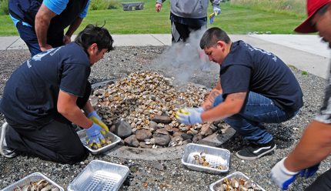
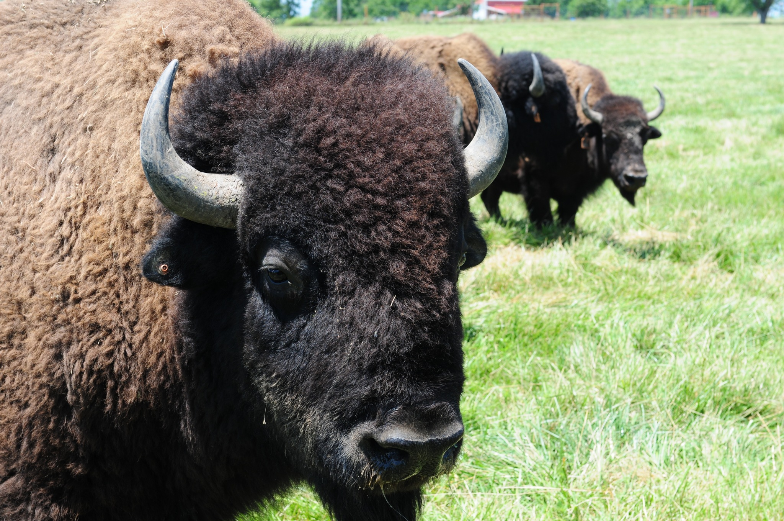
Indigenous Food and Agriculture Initiative University of Arkansas Office of Economic Development
Indigenous Food and Agriculture Initiative
Our Founding
Established in the University of Arkansas School of Law in 2013 by:
Dean Emeritus Stacy Leeds; and
Founding Director Janie Simms Hipp
Our Mission
Enhance health and wellness in tribal communities by advancing healthy food systems, diversified economic development, and cultural food traditions in Indian Country.

Slide 4
Our Work in Indian Country
Our Work in Indian Country
Model Tribal Food and Agriculture Code
Cultivating Tribal Food Sovereignty
Facilitating agricultural production through tribal food sovereignty
Comprehensive set of food and agriculture laws for review, adoption, and implementation by tribes
Food and Agriculture ‘Scaling Up’
Native Farm Bill Coalition
Agricultural production tools and economic forecast models to help build strong Tribal food businesses and food systems
Research partner for the largest-ever coordinated effort in Indian Country around federal food, agriculture, and nutrition policy
Tribal Hemp
Tribal Food Safety Alliance
Policy research and analysis of industrial hemp production
Providing education, training, and outreach to tribal nations and communities, food growers, processors, and manufacturers on FSMA
Food Security and Access
Development of educational resources and research for child nutrition and food access programs in Indian Country
Native Youth in Food and
Agriculture Leadership Summit
Food and agricultural production and policy skills-development leadership summit for Indigenous youth

Slide 5
Identify Production Output Levels and Market Requirements
Identifying your potential scope or scale of production is an important first step:
Scale: Level of production for one good
Scope: Level of diversification, i.e. the number of distinct goods or services produced
Ex:
1 Acre
For each area of production, consider the following questions:
What product(s) do you intend produce, e.g. cover cropping?
What is the amount (either quantity of products or total pounds) of harvest you expect to grow?

Slide 6
Navigating Potential Distribution Channels
Node
Many people may be tempted to think about where they fit in the full supply chain
Distribution Channels
the systems & processes through which goods and services are moved across the supply chain
Node
an organization or individual that produces or moves goods or services across the supply chain
Link
connection points between nodes
Link
Ag Enterprise

Slide 7
Navigating Potential Distribution Channels
2nd Tier Vendors
Node
Many people may be tempted to think about where they fit in the full supply chain
It’s important to build a relationship with the 1st Tier of Vendors & Customers, i.e.
All Nodes 1 Link Up
All Nodes 1 Link Down
Link
1st Tier Vendors
Or Land for Farms
Ag Enterprise
1st Tier Customers
2nd Tier Customers

Slide 8
Navigating Potential Distribution Channels
2nd Tier Vendors
Part of Tribal Food Sovereignty may look at building a closed system supply chain
Nodes of production and distribution largely owned by and operate within
Indian Country
Serving outside customers promote monetary circulation in the Tribal economies
1st Tier Vendors
Or Land for Farms
Ag Enterprise
1st Tier Customers
2nd Tier Customers

Slide 9
Navigating Potential Distribution Channels
When looking at selling through potential markets, it’s important to identify a vendor’s purchase order requirements:
Required Production Scale: Whether production levels can be sustained to meet purchase order minimums
Required Food Specifications: Standard characteristics identified as desirable or required, e.g. quality, grade, certifications
How does potential revenue generated weigh against production inputs?

Slide 10
Navigating Potential Distribution Channels: Understanding Inventory in Context
Cost of Goods Sold are costs related to producing all products of a distinct, marketable type and/or all marketable products, e.g.
Labor
Inputs, e.g. materials used for production
Overhead (utilities, rent, rent, insurance)
Gross
Margin
Sales – Cost of Goods Sold
Sales
Gross Margin as percentage indicates the amount of sales revenue remaining to cover other costs, fees, capital improvements (renovations and new production equipment/tools), or pay owner(s).

Slide 11
Navigating Potential Distribution Channels: Understanding Inventory in Context
Profit Margin is the profitability of all products marketed or the profitability of all products marketed of a specific type/category, e.g. strawberries
Gross Margin is not the same as Profit Margin
Profit Margin
Sales – Total Expenses
Sales
Profit Margin
Gross Margin
may mean that the farm is highly leveraged
(carries more debt liability than owner equity)
don’t expect these ratios to be even, but they can be equitable

Slide 12
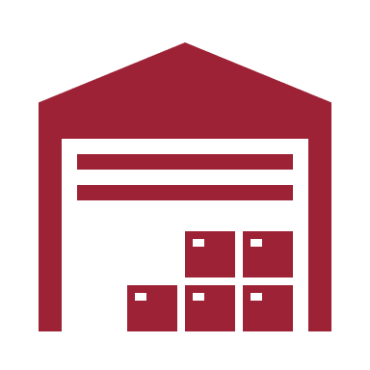
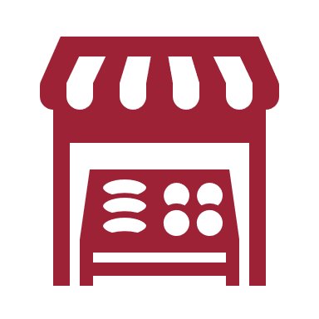
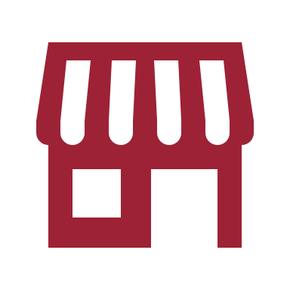
Navigating Potential Distribution Channels
Remember
The scale of production and food specifications required by each distribution channel can differ
Scaling operations may be more challenging initially than altering production strategies
Public Institution
Wholesale / Distributor
Grocer/C- Store
Number of Food Specifications Generally Required
Restaurant
Farmers Market
Key:
Channel Managed Externally
Channel Managed Internally by the Ag Enterprise
Food Stand
U-Pick
Community-Supported Agriculture
Rate of Volume Food Availability Generally Required

Slide 13
Navigating Potential Distribution Channels
Building Food Economies of Scale
One of the main obstacles to accessing a distribution channel is meeting scale of production
Farms can only produce so much as their assets allow before production becomes cost prohibitive or not feasible (diseconomies of scale)
Goal
Marginal
Cost
Average Total Cost
=
Cost
Economies of Scale
Quantity of Product Available for Market
Diseconomies of Scale
Quantity of
Goods or Services
Produced

Slide 14
Navigating Potential Distribution Channels
Building Food Economies of Scale
One of the main obstacles to accessing a distribution channel is meeting scale of production
Farms can only produce so much as their assets allow before production becomes cost prohibitive or not feasible (diseconomies of scale)
Marginal
Cost
Average Total Cost
=
Options
Cost
Economies of Scale
Starting Small and Growing
operations to progressively increase their cashflow and purchase or improve assets
(land, equipment, etc.)
Diseconomies of Scale
Quantity of
Goods or Services
Produced

Slide 15
Navigating Potential Distribution Channels
Building Food Economies of Scale
One of the main obstacles to accessing a distribution channel is meeting scale of production
Farms can only produce so much as their assets allow before production becomes cost prohibitive or not feasible (diseconomies of scale)
Marginal
Cost
Average Total Cost
=
Options
Cost
Economies of Scale
Starting Small and Growing
operations to progressively increase their cashflow and purchase or improve assets
(land, equipment, etc.)
Partner with an Aggregator
food hubs and cooperatives consolidate agricultural products to meet market needs
Diseconomies of Scale
Quantity of
Goods or Services
Produced

Slide 16
Navigating Potential Distribution Channels
Building Food Economies of Scale
One of the main obstacles to accessing a distribution channel is meeting scale of production
Farms can only produce so much as their assets allow before production becomes cost prohibitive or not feasible (diseconomies of scale)
Marginal
Cost
Average Total Cost
=
Options
Cost
Economies of Scale
Starting Small and Growing
operations to progressively increase their cashflow and purchase or improve assets
(land, equipment, etc.)
Partner with an Aggregator
food hubs and cooperatives consolidate agricultural products to meet market needs
Diseconomies of Scale
Entering New and/or Multiple Markets
diversifying distribution channels provides for a more resilient supply chain and provides an opportunity to scale
quantity of production
Quantity of
Goods or Services
Produced

Slide 17
Modeling Resilience in Food Supply Chains
Contemporary supply chains focused on efficiency, where each link and node was singularly required to fulfill its role
Delays or breakages in links impacted subsequent distribution
COVID-19 emphasized the importance of managing relationships reinforcing resilience

Slide 18
Modeling Resilience in Food Supply Chains
Nearshoring
Identifying and purchasing from suppliers closer to your operation
Prioritizing Suppliers
Determine which suppliers provide strategic value or are transactional
Decreases lead time for filling order
Prioritizes relationships based on necessity
Diversifying & Building Redundancy
Purchasing supplies and operation inputs from multiple suppliers
Diversifying Market Access
Sourcing products and goods to multiple markets
Suppliers fill gaps where others see delays
Supports consistent revenue streams
Communication
Building relationships and dialogue with suppliers and customers
Fosters awareness of any issues or delays
Source: Remko van Hoek, 2021

Slide 19
Accessing New Markets
USDA Agricultural Marketing Service procures food from certified vendors
Vendors don’t need to fill the full order but must be able to provide at least a minimum quantity, e.g. a truckload
Webinar May 30, 2019
How to Become a USDA-AMS Certified Vendor
https://www.ams.usda.gov/selling-food

Slide 20
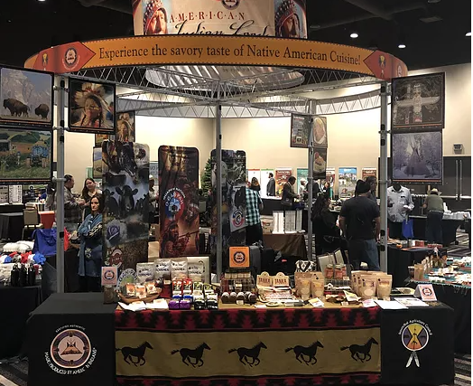
Accessing New Markets
Intertribal Agriculture Council Programs
https://www.indianagfoods.org/aifprogram
AIF Export Program
Through our export program, we provide members with a platform to showcase their products/goods and culture with the world through international trade show activities and buyer missions. Activities emphasize export readiness and exposure to international markets.
​
Native Food Connection
Creating domestic market opportunities for Native American and Alaskan Native agribusinesses while providing marketing education and collaboration with Native conferences.

Slide 21
Empowering Indian Country through economic development and greater food access
Indigenous Food and Agriculture Initiative
University of Arkansas
Fayetteville, AR
www.indigenousfoodandag.com
www.nativefoodsafety.org

